Slide 1

Hardware
IoT BASED ICU PATIENT MONITORING SYSTEM
SOC Review-III
Batch No-3
Supervisor
Mr .K. P. Swaroop
Assistant Professor , EEE
Presented By
A. Mokshagna-22B01A0201
B. Bhavya Sai Chandrika-22B01A0208
L. Keerthi Sri-22B01A0231
M. Keerthana-22B01A0235
Department of Electrical and Electronics Engineering
Shri Vishnu Engineering College for Women (A)
Bhimavaram, Andhra Pradesh - 534201

Slide 2
CONTENTS
Introduction
Literature Review
Problem Statement
Objectives
Block Diagram
Components & Specifications
Gantt Chart
References

Slide 3
Introduction:
Intensive Care Unit or ICU is where the patients who are critically ill are admitted for treatment. For such critical conditions the Doctors need to have an all-time update patient’s health related parameters like their blood pressure, heart pulse and temperature. For this type of situations this IoT based system can bring about an automation that can keep the Doctors updated all time over internet.
IoT Based ICU Patient Monitoring System which collects patient’s information with the help of few sensors. There is a Blood pressure and heart beat monitor module electrically connected to the system. On the press of button, the sensor senses the blood pressure in systolic and diastolic along with the heart beat and sends it to the central controller. The Temperature sensor senses the temperature of its ambience, so when this sensor is in close proximity of the user it reports the users’ body temperature. In this way IoT Based ICU Patient Monitoring System is an enhanced system that helps in monitoring ICU Patients without any manual intervention.

Slide 4
Literature Review:
SL. No | Title and Author’s | Paper Details | Description | Key Findings
1. | Title : IoT Based ICU Patient Monitoring System Author’s : Sai Srinivas Vellela, G Varshitha, V Suresh, V Sai Vineeth, L Venkata Suresh. | IoT Based ICU Patient Monitoring System, International Journal for Modern Trends in Science and Technology, 2024, 10(02), pages. 265-273. | The "IoT-Based ICU Patient Monitoring System" is a cutting-edge project designed to revolutionize patient care in Intensive Care Units (ICUs). Leveraging Internet of Things (IoT)technologies, the system integrates various sensors, communication modules, and data analytics to enable continuous and real-time monitoring of critical health parameters. | An IoT-based patient monitoring system utilizing ECG sensors represents a pioneering approach to healthcare , merging cutting-edge technology with personalized patient care.
2. | Title :IoT Based Patient Monitoring System using Sensors to Detect, Analysis and Monitor Two Primary Vital Signs. Author’s :Nor Shahanim Mohamad Hadis*, Muhammad Nazri Amirnazarullah, Muhammad Mahdi Jafri, Samihah Abdullah. | Journal of physics : Conference series , volume 1535,29-30-April 2019,Penang, Malaysia. | This paper presents the development of patient monitoring system for two primary vital signs of body temperature and respiratory rate. The monitoring system was implemented in IoT platform and designed using Arduino Mega 2560 and ESP8266 Wi-Fi Module. | Hospital is a busy place with the doctors and nurses work hard to saves lives and improving patient’s health. The vital signs are usually used as the important measurements to the patient’s body.
3. | Title : "IoT Based Patient Monitoring System for ICU: A Real-Time Approach” Author’s : S. S. Rao, A. K. Singh, and M. A. Hussain | Journal: IEEE Journal of Biomedical and Health Informatics- Volume: 24- Issue: 3- Pages: 831-838- Year: 2020- DOI: 10.1109/JBHI.2019.2944993 | This paper proposes an IoT-based patient monitoring system for ICUs, enabling real-time monitoring of patients' vital signs and health parameters. The system uses wearable sensors, IoT devices, and cloud computing to provide remote monitoring and automated alerts. | The proposed system achieved 95% accuracy in monitoring patients' vital signs. The system reduced response time to emergencies by 30% compared to traditional monitoring methods. The system improved patient care and outcomes by enabling timely interventions.

Slide 5
Problem Statement:
Design and implement an IoT-based ICU patient monitoring system that allows real-time monitoring of vital signs and conditions of patients in intensive care units.

Slide 6
Objectives:
The goal of monitoring the patient is to detect problems and manage them as early as possible.
To sustain life
To prevent , reverse or minimize damage to vital organs.
Develop a mechanism for real-time transmission of sensor data from the patient to a central monitoring system.
Implement an alarm system to alert healthcare providers in case of abnormal vital signs or critical changes in the patient's condition.

Slide 7
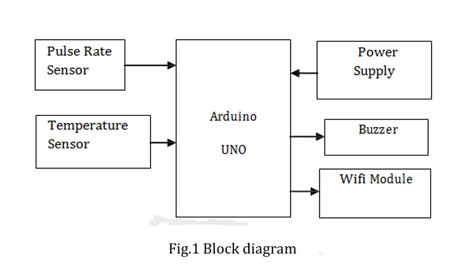
Block diagram:

Slide 8
Components & Specifications:
Hardware Specifications :
Power Supply(9V)
LCD Display
Temperature Sensor(LM35)
Pulse rate Sensor
WIFI module-ESP8266
Arduino UNO
Buzzer

Slide 9
Hardware testing and implementation stage:
The hardware testing and implementation stage of our IoT-based ICU patient monitoring system involves rigorous testing of the sensors and other hardware components to ensure seamless integration and accurate data transmission.
We conduct functional testing of the sensors to ensure precise monitoring of vital signs, such as heart rate, blood pressure, and temperature.
Our team ensures proper installation and maintenance of the hardware to guarantee optimal performance and patient safety.

Slide 10
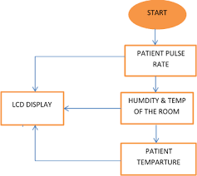
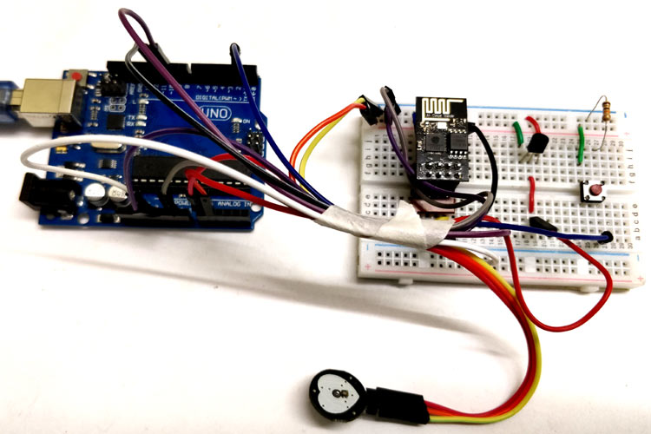

Slide 11
Gantt Chart
Reviews | Review 1 | Review 2 | Review 3 | Review 4
Abstract Review
Literature Survey
Mathematical Analysis / Model Design
Component Testing/Simulation Design
Hardware/Simulation Implementation

Slide 12
References:
"IoT-Based Patient Monitoring System for ICU" by S. S. Rao et al. (2020)
"Real-Time Patient Monitoring System Using IoT" by A. K. Singh et al. (2019)
"IoT-Based Remote Patient Monitoring System for ICU" by M. A. Hussain et al. (2018)
Mr. Alam “IOT Based Patient Health Monitoring Using ESP8266 & Arduino”[June 11,2019]
Engr Fadhad IoT Based Patient Monitoring System Using ESP8266,Arduino &Android Bluetooth App”[August 31,2019]
https://www.engineersgarage.com/what-is-gsm-gprs- module[0ct [11 ,2017]
https://tkkrlab.nl/wiki/Arduino_37_sensors [Oct 20, 2017]

Slide 13
Thank You
&
Any Queries ?

